Slide 1


A Semantic Specification for Data Protection Impact Assessments (DPIA)
Harsh(vardhan J. Pandit)
Research Fellow @ ADAPT Centre, Trinity College Dublin
Email: pandith@tcd.ie | Twitter: @coolharsh55
https://harshp.com/research/presentations
Presentation for SEMANTiCS 2022

Slide 2
GDPR & DPIA
1) Art.35 Data Protection
Impact Assessments
2) Check if there may be high-risk to data subjects
3) Risk assessed for/to rights and freedoms
DPIA 3-step Process
1) Assess need for DPIA
2) Conduct the DPIA
3) Change Processing
source: CNIL (FR) https://www.cnil.fr/en/guidelines-dpia

Slide 3
To conduct a DPIA, you need:
Details of how personal data is processed
unique for use-case
Risks involved or possible for the operations
common
elements
Security and other risk mitigation measures applied
A risk assessment methodology and process
Documentation and Records of the Above
automate
machine-readable
RQ: How to assist with this?
share information
simplify risk assessment
interoperable format
queryable
verifiable
assist with other GDPR compliance
practical application
reuse standards & guidelines

Slide 4

Variance in Knowledge
Guidelines by Data Protection Authorities
GDPR Case Law / Court Arguments and Opinions
Legal Consultancy Reports
DPIAs published in the public domain
ISO 31000 series for Risk Management
FAIR (Factor Analysis of Information Risk)

Slide 5
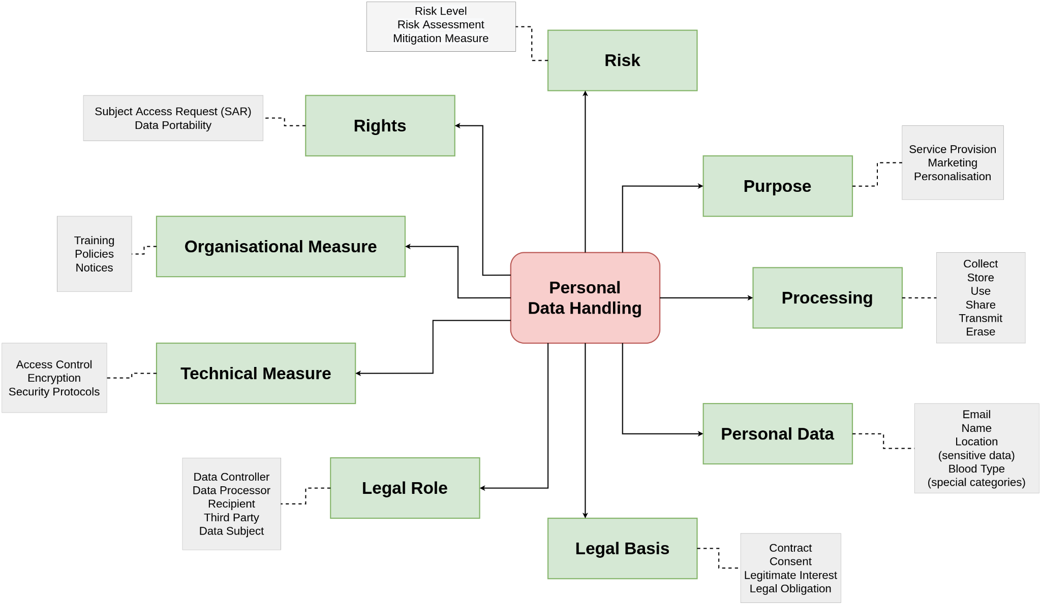

Data Privacy Vocabulary (DPV)
Description of Personal Data Processing
https://w3id.org/dpv
:Taxonomies:
Purpose Personal Data Processing Legal Basis Legal Role Tech/Org Measures Risk Rights
Serialisations RDF (canonical) CSV, JSON
Semantics RDFS+SKOS OWL2
We invite comments and feedbacks for publishing DPV v1 - a significant milestone. See DPV spec for more details. Comment period: up to OCT-15

Slide 6
What was missing?
In DPV and State of the Art
DPIA considered an isolated process, not part of the larger processing activities and knowledge
Granularity of DPIA as a process e.g. necessity assessment, risk assessment, changes made to processing
Recording outcomes of each step
Concepts required for determining high-risk criteria (e.g. scale of data subjects, volume of data) - and their analysis
Risk Ontology / Semantic Risk specification

Slide 7
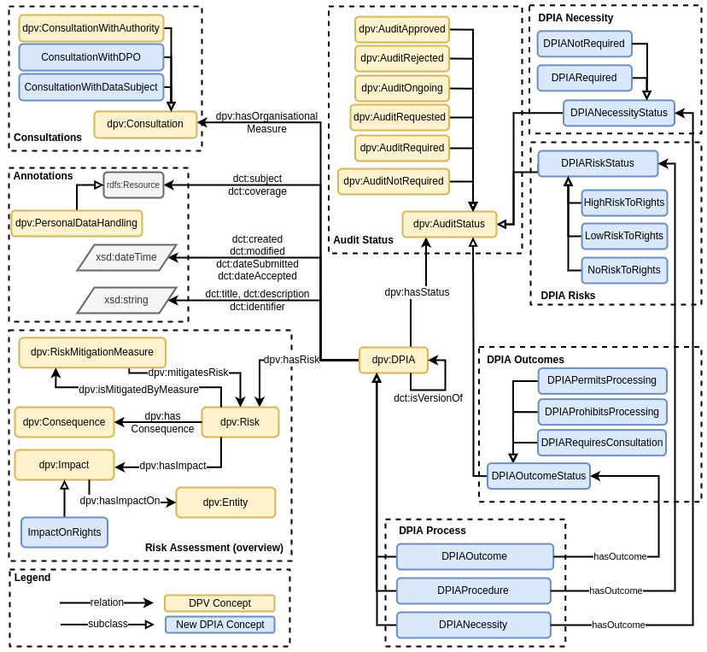
Consultations
Authority
DPO
Data Subject
DPIA Necessity
Required
Not Required
DPIA as Audit
- Approved
Not Approved
Requested
Rejected
Required
Not Required
Ongoing
Risk Status
High Risk
Low Risk
No Risk
gdpr/dpia
DPIA Outcomes
Permit
Prohibit
Consultation
Risk
Mitigation
Consequence
Impact
Level
Severity
DPIA Process
Necessity
Procedure
Outcome
Rights and Freedoms Taxonomy from EU Charter
https://w3id.org/dpv/dpv-gdpr/dpia

Slide 8
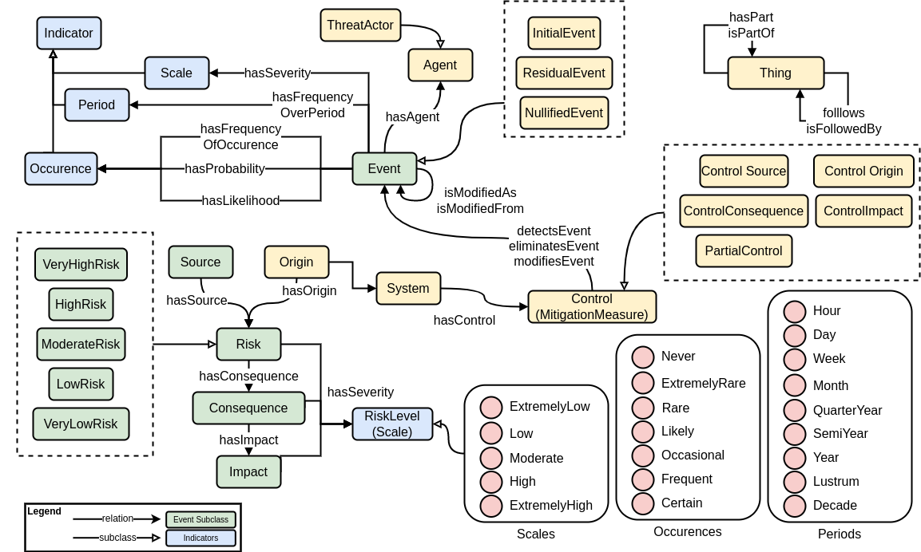
Risk Ontology based on ISO 31000 series
Control
Risk
Consequence
Level
Impact

Slide 9

Risk Frameworks are too diverse for consistency
Challenge: How to create an interoperable ontology?
this work only focused on GDPR and DPIA

Slide 10
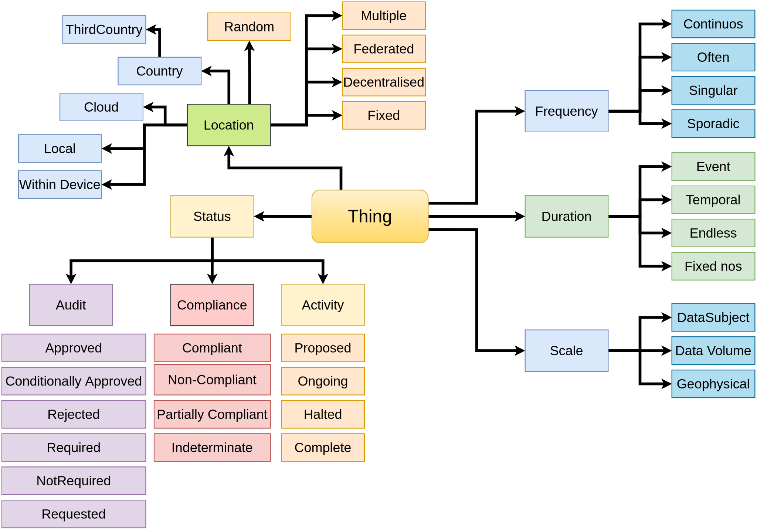
Developments made in DPV
risk extension https://w3id.org/dpv/risk
Risk Likelihood, Severity
Risk Levels
Risk Matrix (3x3, 5x5, 7x7)
Controls
Consequences & Impacts
Assessment methods
Methodologies
contextual information for all kinds of processes and scales

Slide 11
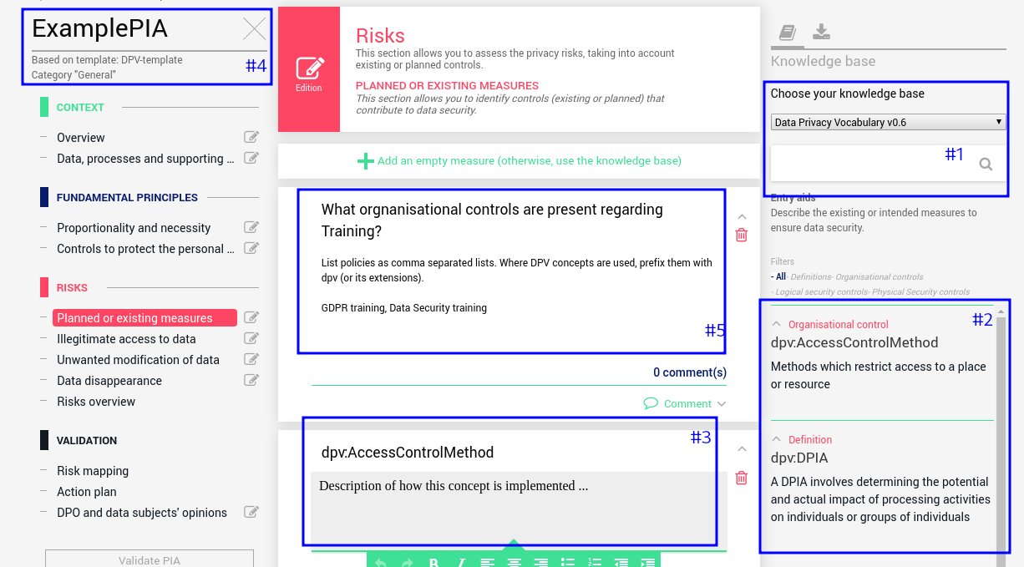
Applications
* CNIL’s PIA tool for managing and exporting DPIA data and using “knowledge bases”
* Imported DPV and DPIA spec as KB’s and reused (semantic) concepts within the PIA tool
Issues
* Difficulties from lack of documentation regarding KBs
* No Reasoning component so no semantics advantage
CNIL’s PIA Software https://www.cnil.fr/en/privacy-impact-assessment-pia
Another application: Model DPIA documents published by SURF about Zoom, Office 365, Google Apps
Issues: lack of structure, no vocabulary for some concepts, complexity of services

Slide 12




practicalities
lack of semantic vocabularies - we need more metadata
Next steps: look at ISO standards, specifically the 31K and 27K series, ENISA reports and documents, Germany’s Standard Data Protection Model (SDM)
knowledge representation requires domain experts
DPIA information is unstructured, in PDFs (at best), and is very difficult to convert into semantic vocabulary
Next steps: enrich DPV concepts to reflect as much of the real-world as possible, undertake systematic analysis of ALL guidelines from EU DPAs to identify requirements, create an “ideal DPIA specification” and align inputs to that
shared impact assessments - DPIA, data transfer, etc.
risk sources, causes, controls, consequences, impacts are duplicated across every impact assessments
Next steps: create a common template for “impact assessment” and specialise that for specific tasks — also look towards assessments in future regulations

Slide 13

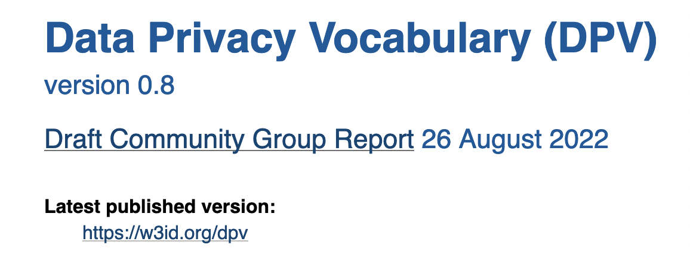
interested? questions? contact at:
DPV Specification https://w3id.org/dpv
Github https://github.com/w3c/dpv/ Joining DPVCG https://www.w3.org/community/dpvcg/
We invite comments and feedbacks for publishing DPV v1 - a significant milestone. See DPV spec for more details. Comment period: up to OCT-15
twitter@coolharsh55 pandith@tcd.ie
dpv@harshp.com
public-dpvcg@w3.org
A Semantic Specification for Data Protection Impact Assessments (DPIA)
https://w3id.org/dpv/dpv-gdpr/dpia

